Slide 1

Google App Engine Tutorial
Joe Gregorio
Developer Advocate
Google App Engine
Joe Gregorio
Developer Advocate
Google App Engine

Slide 2
Templates
Files and templating

Slide 3
Overview
Load Template
Render
Response

Slide 4
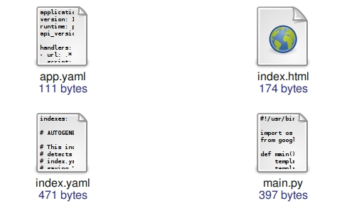
The contents of tutorial2

Slide 5
app.yaml
application: jcgregorio-test
version: 1
runtime: python
api_version: 1
handlers:
- url: .*
script: main.py

Slide 6
index.html
<!DOCTYPE HTML>
<html>
<head>
<title> Hello World </title>
</head>
<body>
<p>This is dynamic content
<b>{{ foo }}</b> at it's finest.</p>
</body>
</html>

Slide 7
main.py
import os
from google.appengine.ext.webapp import template
def main():
template_values = {"foo" : 1}
template_file = os.path.join(
os.path.dirname(__file__), "index.html")
body = template.render(
template_file, template_values)
print "Status: 200 OK"
print "Content-type: text/html"
print
print body
if __name__ == '__main__':
main()

Slide 8
'template' is a simple wrapper around Django 0.96 templates
import os
from google.appengine.ext.webapp import template
def main():
template_values = {"foo" : 1}
template_file = os.path.join(
os.path.dirname(__file__), "index.html")
body = template.render(
template_file, template_values)
print "Status: 200 OK"
print "Content-type: text/html"
print
print body
if __name__ == '__main__':
main()

Slide 9
Absolute path names
import os
from google.appengine.ext.webapp import template
def main():
template_values = {"foo" : 1}
template_file = os.path.join(
os.path.dirname(__file__), "index.html")
body = template.render(
template_file, template_values)
print "Status: 200 OK"
print "Content-type: text/html"
print
print body
if __name__ == '__main__':
main()

Slide 10
The 'main()' optimization
import os
from google.appengine.ext.webapp import template
def main():
template_values = {"foo" : 1}
template_file = os.path.join(
os.path.dirname(__file__), "index.html")
body = template.render(
template_file, template_values)
print "Status: 200 OK"
print "Content-type: text/html"
print
print body
if __name__ == '__main__':
main()

Slide 11
Practice
template_values = {"foo" : 1}
template_values = {"foo" : “1”}
template_values = {"foo" : [1, 2, 3]}
template_values = {"foo" : {“bar”: 2} }

Slide 12
Thank You
Questions?

